Slide 1



OnyxChallenge Dec 2021
View in Power BI
Last data refresh:
12/6/2021 2:42:56 AM UTC
Downloaded at:
12/13/2021 11:01:26 PM UTC

Slide 2
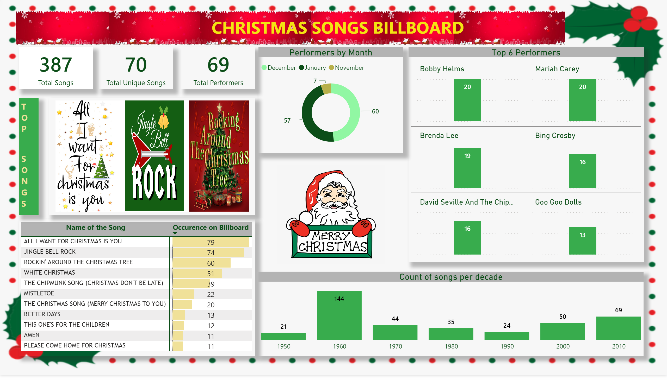
Dashboard
Notes:
image
No alt text provided.
image
No alt text provided.
image
No alt text provided.
image
No alt text provided.
image
No alt text provided.
image
No alt text provided.
textbox
No alt text provided.
card
No alt text provided.
card
No alt text provided.
card
No alt text provided.
Performers by Month
No alt text provided.
pivotTable
No alt text provided.
image
No alt text provided.
textbox
No alt text provided.
Count of songs per decade
No alt text provided.
Top 6 Performers
No alt text provided.
image
No alt text provided.

